Slide 1
Mu2e: Search for Muon to Electron Conversion at Fermilab
Eric Prebys Fermilab
For the Mu2e Collaboration

Slide 2
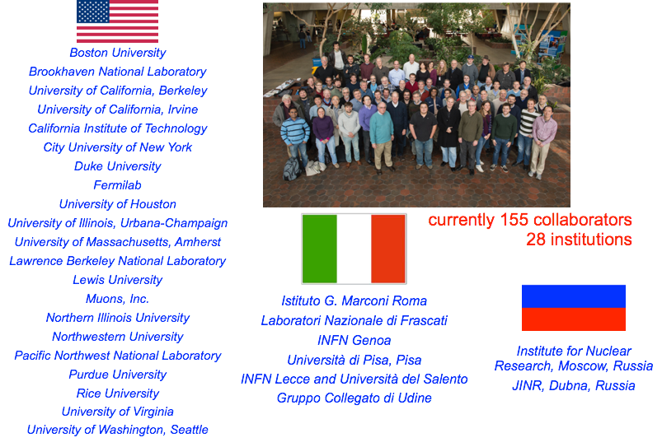
Mu2e Collaboration

Slide 3
Outline
Theoretical Motivation
Experimental Technique
Making Mu2e work at Fermilab
Sensitivities
Future Upgrades
Conclusion
Will spend quite a bit of time on this

Slide 4
Provocative Comments
Once upon a time, high energy physics moved forward by going to higher energies and “seeing what came out”.
The last time this happened was the discovery of the tau lepton and b quark in the 70s!
For the last 40 years, all other discoveries have been preceded by strong indirect evidence
K➔μ⁺μ⁻ suppression ➔ charm quark
CP Violation ➔ third generation
Weak decays ➔ W and Z particles and their masses
Precision tests at LEP and elsewhere ➔ top and Higgs masses
With the discovery of the Higgs, we now find ourselves without guidance for the first time in half a century
The LHC was “guaranteed” to discover the Higgs (or it would have been even more interesting)
No one knows the next “sure bet” energy!
If the past is any indicator, such guidance will likely come from indirect evidence.

Slide 5
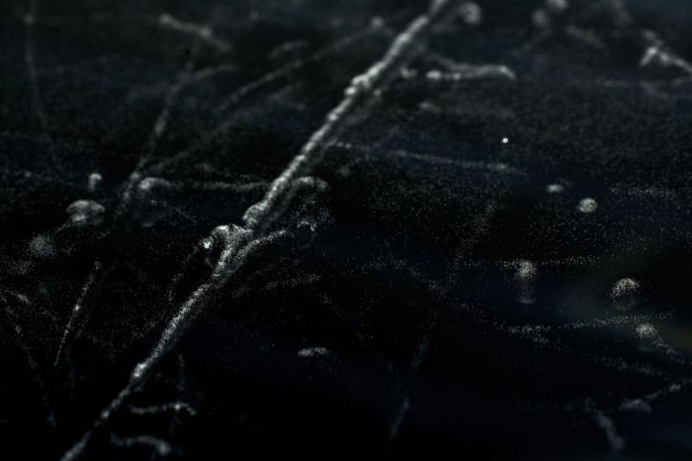
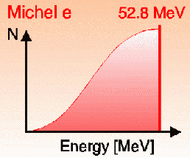
Ancient History
The muon was originally discovered in 1936 Anderson and Neddermeyer while studying cosmic ray data
Hypothesized to be Yukawa’s proposed mediator of the nuclear binding force, but did not interact strongly
Yukawa’s particle was the pion
Excited electron?
If so, expect
Not seen!
The muon was observed to decay to electron+”something invisible” with a spectrum consistent with a three body decay
Fast forwarding (and skipping a whole bunch of stuff)…

Slide 6
Introducing: the Muon
Mass: 105.66 MeV/c² (~200m_{e} ~0.1m_{p})
Charge: ±e
Spin: ½ħ (fermion)
Lifetime: 2.2 μsec (cτ=660m)
Interactions: Electromagnetic and Weak, but NOT strong
Because muons are so much heavier than electrons, they are very penetrating

Slide 7
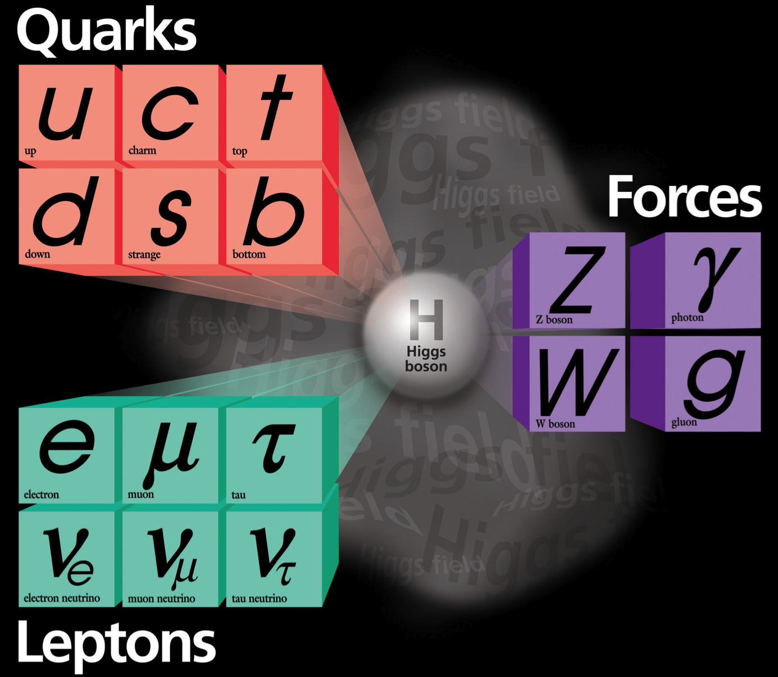
The Standard Model
Fermions
Bosons
Combine to form hadrons
Mediate interactions
Free
Weak charged current interactions “flip” fundamental fermions (analogous to EM spin flip)
Neutrino mixing

Slide 8
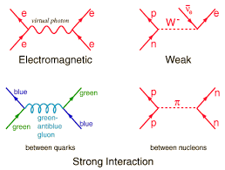
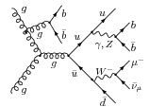
Interactions in the Standard Model

Slide 9
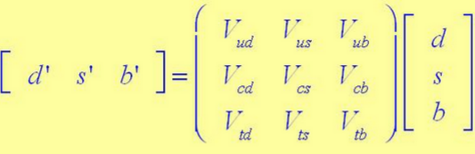
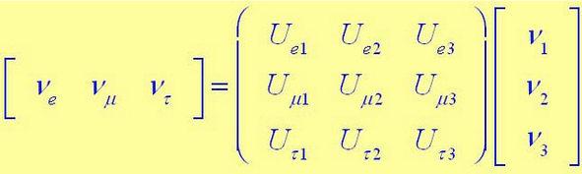
Generation (Flavor) Transitions
In both the quark and lepton sector, the weak eigenstates are related to the mass eigenstates by a unitary matrix
However, because the neutrino mass differences are so small, the phenomenology is very different
“almost” diagonal
~maximum mixing
Quarks: generational transitions observed
Leptons: weak transitions and mixing proceed separately
Pure weak state. Propagates as a superposition of mass eigenstates➔”neutrino mixing”
NOT observed!

Slide 10
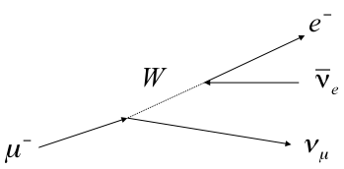
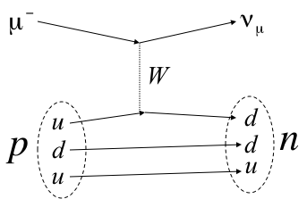
Lepton Number and Lepton Flavor Number
Both lepton number and lepton “flavor” (generation) number are individually conserved*
muon decay
μ+p➔ν+n
*except in neutrino mixing

Slide 11
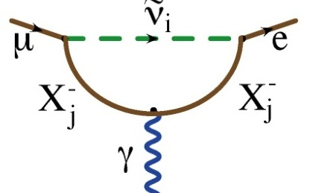
Charged Lepton Flavor Violation
Neutral Current Scattering
Higher order dipole “penguin”:
Virtual ν mixing
OK
Flavor Changing Neutral Current (FCNC):
Observation of neutrino mixing shows this can occur at a very small rate
Photon can be real (μ->eγ) or virtual (μN->eN)
Standard model branching ratio ~O(10⁻⁵²) (effectively zero)
Forbidden in Standard Model

Slide 12
Beyond the Standard Model
Because extensions to the Standard Model couple the lepton and quark sectors, Charged Lepton Flavor Violation (CLFV) is a nearly universal feature of such models.
The fact that it has not yet been observed already places strong constraints on these models.
CLFV is a powerful probe of multi-TeV scale dynamics
complementary to direct collider searches
Among various possible CLFV modes, rare muon processes offer the best combination of new physics reach and experimental sensitivity

Slide 13

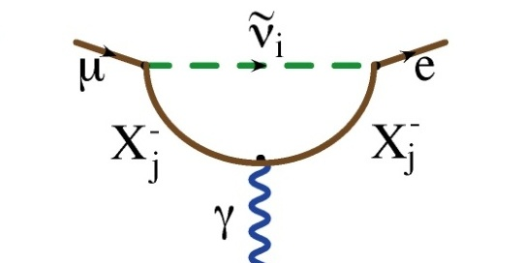
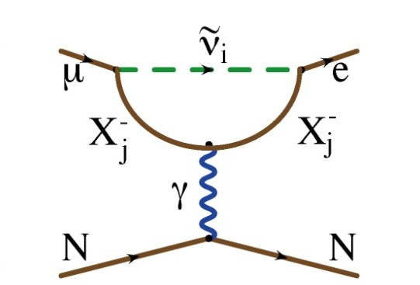
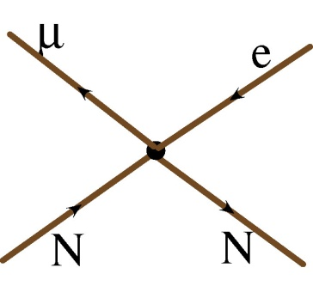
Generic Beyond Standard Model CLFV
Flavor Changing Neutral Current
Dipole (penguin)
Can involve a real photon
Or a virtual photon
?
?
?
Mediated by virtual(!) massive neutral Boson, e.g.
Leptoquark
Z’
Composite
Approximated by “four fermi interaction”
?
?
?

Slide 14

Decay vs. Conversion
Only the “dipole”-like reactions can lead to a decay
However, if we capture a muon on a nucleus, it could exchange either a virtual photon or other (as yet unknown) neutral boson with the nucleus

Slide 15
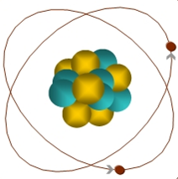
Experimental Signature of μ+N → e+N
When captured by a nucleus, a muon will have an enhanced probability of exchanging a virtual particle with the nucleus.
This reaction recoils against the entire nucleus, producing a mono-energetic electron carrying most of the muon rest energy
μ
~105 MeV e⁻
Similar to μ→eγ, with important advantages:
No combinatorial background.
Because the virtual particle can be a photon or heavy neutral boson, this reaction is sensitive to a broader range of new physics.
Relative rate of μ→eγ and μN→eN is the most important clue regarding the details of the physics

Slide 16
What We (Plan to) Measure
We will measure the rate of μ to e conversion…
…relative to ordinary μ capture
This is defined as

Slide 17
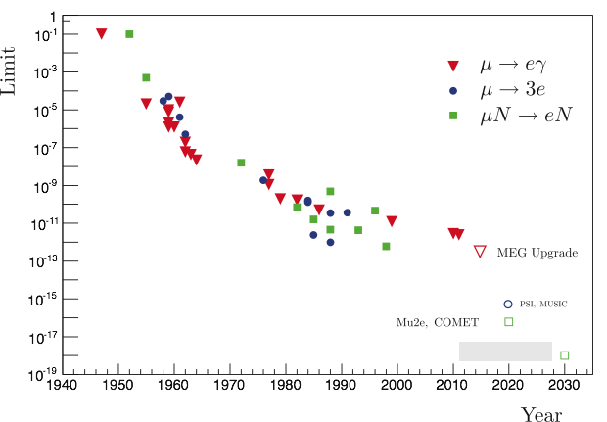
History of Lepton Flavor Violation Searches
90% C.L.
Best Limits
R_{μe}<7x10⁻¹³ (Sindrum-II 2006)
Br(μ➔eγ) < 6x10⁻¹³ (MEG 2013)
Br(μ➔3e) < 1x10⁻¹² (Sindrum-I 1988)
Not quite apples-to-apples, but…
R. Berstein
Mu2e will measure:
Goal: single event sensitivity of R_{μe}=3x10⁻¹⁷

Slide 18
Just to be clear…
We are not planning to make a measurement and compare it to a calculation.
We are looking for something that (effectively) doesn’t exist in the Standard Model.
Our goal is to build a experiment with negligible backgrounds, such that any observed signal would be unambiguous evidence of new physics.
We planning for a improvement of roughly four orders of magnitude in sensitivity over the best previous measurement.

Slide 19
Just How Rare is that?
~90% C.L. goal
Single event sensitivity of Mu2e

Slide 20
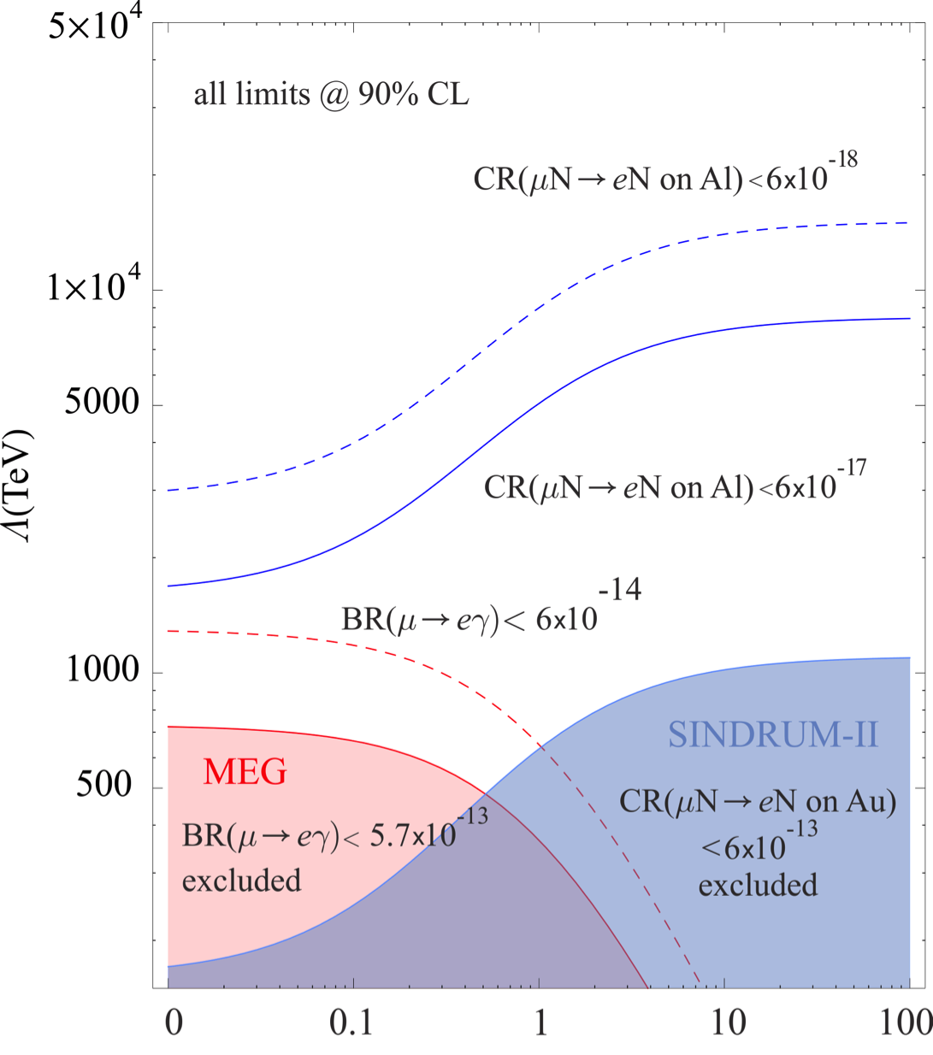
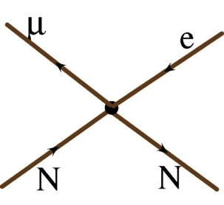
Dipole vs. Contact Reaction
A. de Gouvea
Our goal:
10⁴ in rate
10 in mass
(different for different models)

Slide 21
Example Sensitivities*
Supersymmetry
Second Higgs doublet
Predictions at 10⁻¹⁵
Heavy Neutrinos
Compositeness
Heavy Z’, Anomalous Z coupling
Leptoquarks
*After W. Marciano
No μ➔eγ signal

Slide 22
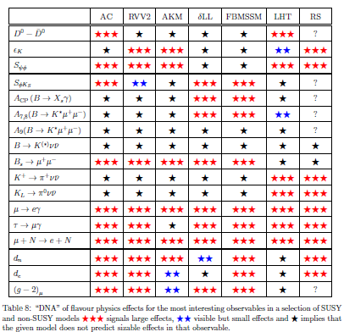
Example: μ→e in Supersymmetry*
SUSY Models
All SUSY models predict both μ➔eγ and μN➔eN
*from Altmannshofer, Buras, et al, Nucl.Phys.B830:17-94, 2010

Slide 23
How do we make muons?
This produces mostly pions
These quickly decay to muons
Hit a target with protons
Muons go much further

Slide 24
Our Biggest Issue: Decay in Orbit (DIO)
In-flight Decay:
Coherent DIO:
N
Very high rate
Peak energy ~53 MeV
Must design detector to be very insensitive to these.
Nucleus coherently balances momentum
Rate approaches conversion (endpoint) energy as ~(E_{conversion}-E)⁵
Drives resolution requirement.

Slide 25
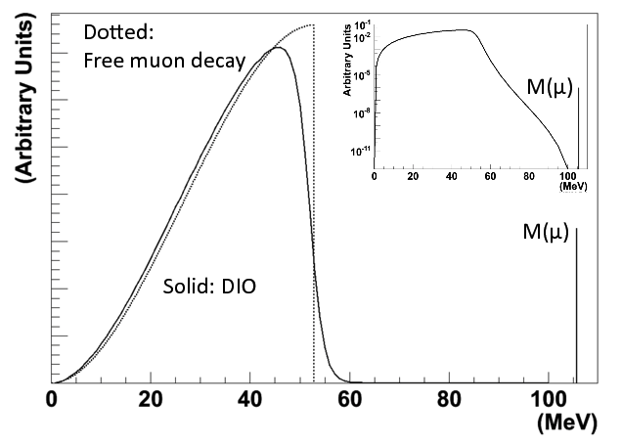
DIO Spectrum
We want to be blind to this (acceptance)
We must resolve this

Slide 26
Prompt Backgrounds
There are significant backgrounds related to the production and transport of the muons.
Radiative π- capture π⁻N →N*γ, γZ → e⁺e⁻
Muon decay in flight μ⁻ → e⁻νν
Pion decay in flight π⁻ → e⁻ν_{e}
Prompt electrons
General approach
Produce muons
Transport muons to target where some are captured.
Wait(!) for prompt backgrounds to go away
Open detection window to look for conversion of captured muons.
Biggest problem

Slide 27
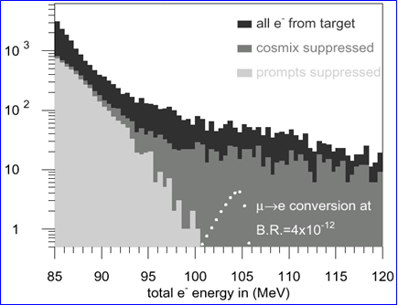
The Problem
μ−>e Conversion: Sindrum II
Cosmic Background
Most backgrounds are prompt with respect to the beam
Mostly radiative pion capture
Previous experiments suppressed these backgrounds by vetoing all observed electrons for a period of time after the arrival of each proton.
This leads to a fundamental to a rate limitation.
DIO tail

Slide 28
Pulsed Beams (first proposed for MELC)
Eliminate prompt beam backgrounds by using a primary beam consisting of short proton pulses with separation on the order of a muon life time
Design a transport channel to optimize the transport of right-sign, low momentum muons from the production target to the muon capture target.
Design a detector which is very insensitive to electrons from ordinary muon decays, and has excellent tracking resolution.
“Nothing” between bunches ➔ ”Extinction”
~200 ns
~1.5 μs
Prompt backgrounds
live window

Slide 29
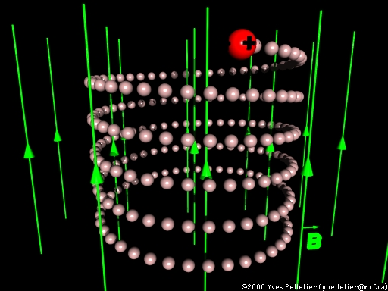
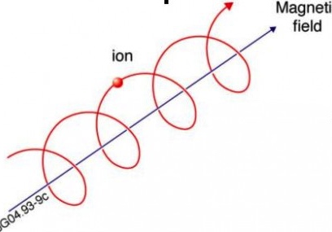
Refresher: Fun with Solenoids
Particles in a solenoidal field will generally move in a helical path
Low momentum particles are effectively “trapped” along the field lines
We use this to transport muons
A particle trapped along a curved solenoidal field will drift out of the plane of curvature
This is how we will resolve muon charge and momentum in the transport line
For higher momentum particles, the curvature can be used to measure momentum
This is how we will measure the momentum of electrons from the capture target
10 MeV/c particle will have a radius of 3 cm in a 1 T field

Slide 30
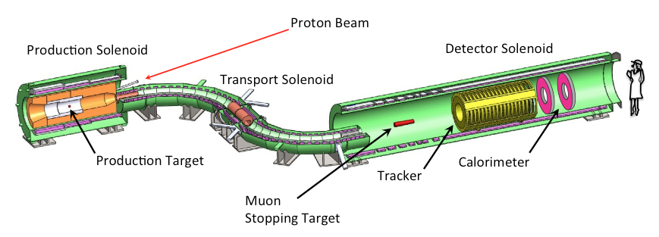
Mu2e: The Big Picture
Production Target
Proton beam strikes target, producing mostly pions
Production Solenoid
Contains backwards pions/muons and reflects slow forward pions/muons
Transport Solenoid
Selects low momentum, negative muons
Capture Target, Detector, and Detector Solenoid
Capture muons on target and wait for them to decay
Detector blind to ordinary (Michel) decays, with E ≤ ½m_{μ}c²
Optimized for E ~ m_{μ}c²

Slide 31
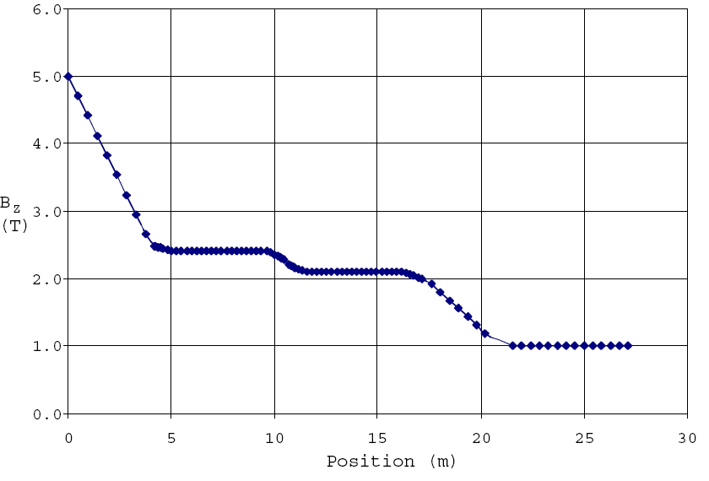
Magnetic Field Gradient
Decreasing field prevents particle trapping and excessive straggling
Production Solenoid
Transport Solenoid
Detector Solenoid

Slide 32
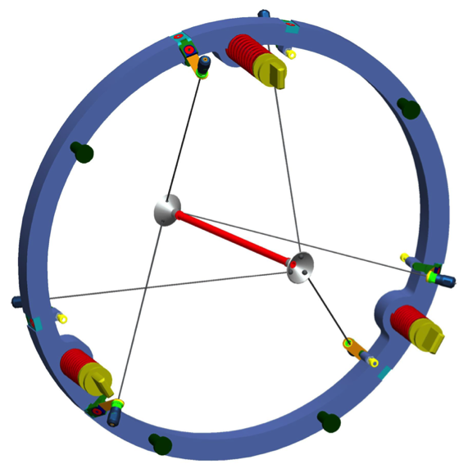
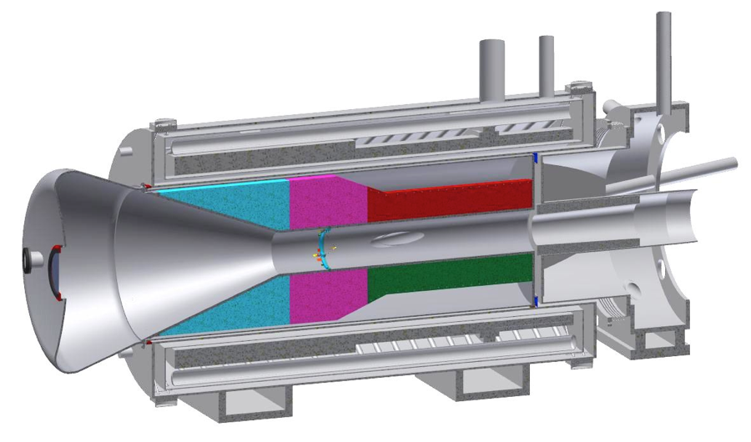
Target and Heat Shield
Remember, this is inside a superconducting magnet
Produces pions which decay into muons
Tungsten Target
8 kW beam
700 W in target
Radiatively cooled
Heat Shield
Bronze insert
3.3 kW average heat load
Target rod
Support

Slide 33
Production Solenoid
Axially graded (~5T➔2.5T) solenoid captures low energy backward and reflected pions, directing to the Transport Solenoid
Magnetic Gradient
Magnetic reflection
(pinch confinement)

Slide 34
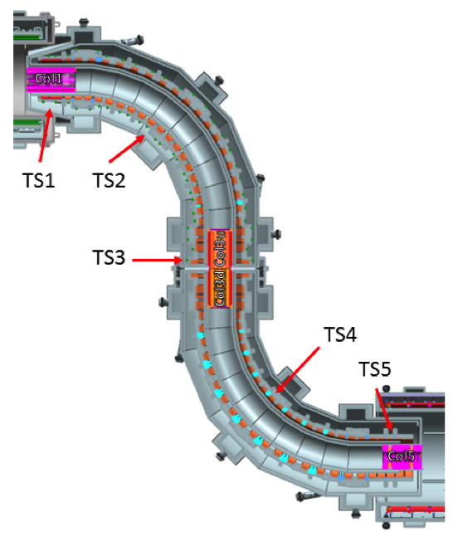
Transport Solenoid
Transports muons from production target to capture target
Curved solenoid eliminates line-of-sight backgrounds
Collimator in center selects low momentum negative muons
RxB drift causes sign/momentum dependent vertical displacement
μ⁻
μ⁺

Slide 35
Choosing the Capture Target
The probability of of exchanging a virtual particle with the nucleus goes up with Z, however
Lifetime is shorter for high-Z
Decreases useful live window
Also, need to avoid background from radiative muon capture limits choices
⇒Want M(Z)-M(Z-1) < signal energy
⇒Aluminum is initial choice for Mu2e
Nucleus
R_{μe}(Z) / R_{μe}(Al)
Bound lifetime
Atomic Bind. Energy(1s)
Conversion Electron Energy
Prob decay >700 ns
Al(13,27)
1.0
.88 μs
0.47 MeV
104.97 MeV
0.45
Ti(22,~48)
1.7
.328 μs
1.36 MeV
104.18 MeV
0.16
Au(79,~197)
~0.8-1.5
.0726 μs
10.08 MeV
95.56 MeV
negligible

Slide 36
Stopping (capture) Target
Multiple thin layers to allow decay or conversion electrons to exit with minimal scattering
17 Aluminum foils
200 μm thick
Stops 49% of arriving muons
Foils
Conversion electron spectrum:
Targets
minimize
Support wires

Slide 37
Detector and Detector Solenoid
Graded field around stopping target to increase acceptance
Magnetic reflection again
Uniform field in tracking volume
Electromagnetic calorimeter to tag electrons.
μ Stopping Target(s)
Muon Absorber
Proton Absorber
Tracker
EM Calorimeter

Slide 38
Particle Detector
Helical trajectory
Charged tracking
Conversions hit multiple planes.
Electromagnetic Calorimeter to tag electrons
Most decays (p_{T}<53 MeV/c) go down the middle (vacuum)

Slide 39
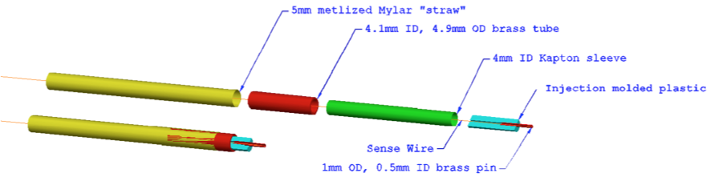
Particle Tracking Technology
To achieve the required resolution, must keep mass as low as possible to minimize scattering
We’ve chosen transverse planes of “straw chambers” (~23,000 straws)
Advantages
Established technology
Modular: support, gas, and electronic connections at the ends, outside of tracking volume
Broken wires isolated
Challenges
Our specified wall thickness (15 μm) has never been done
Operating in a vacuum may be problematic
Track ionizes gas in tube
Charge drifts to sense wire at center
Drift time gives precision position

Slide 40
Calorimeter
The Calorimeter will be used to tag electrons
Electrons will deposit all of their energy
Muons will deposit a small amount of ionization energy
Two layers of 200 mm long BaF₂ crystals
1860 total
Very useful for timing
Tracker Hits
Before timing cut After timing cut

Slide 41
Beam Needs
We’ve talked about the experiment. Now where do we put it?
We need a beam that looks kind of like this
This is where Fermilab comes in…

Slide 42
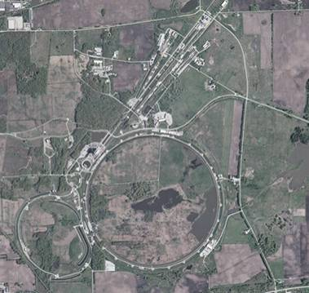
A Brief History of Fermilab (evolving slide)
1968: construction begins
1972: first beams
200➔400 GeV proton beams
Highest energy lab ever since
~1985:
“Tevatron”: first superconducting synchrotron.
900GeV x 900 GeV p-pBar collisions
Upgraded in 1997
Main Injector-> more intensity
980 GeV x 980 GeV p-pBar collisions
Intense neutrino program
Soon the second most powerful collider
Fermilab is now the only remaining US High Energy Physics Lab
With the LHC now the highest energy collider, the lab must focus on different types of physics.
until recently
For awhile

Slide 43
Guidance: The P5 Report
The Particle Physics Project Prioritization Panel (P5) advises the DOE Office of High Energy Physics.
In 2013, the P5 was charged to determine priorities in US particle physics (primarily priorities for Fermilab) under various funding scenarios
In 2014, the panel report recommended proceeding with Mu2e under all scenarios.
So… full speed ahead!

Slide 44
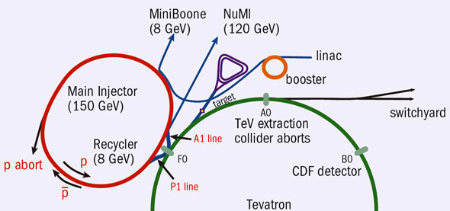
Fermilab Accelerator Complex Today
As LHC takes over the Energy Frontier, Fermilab focuses on intensity-based physics
Accumulator/Debuncher: Formerly for pBar accumulation, soon muon and proton manipulation (Delivery Ring for Mu2e)
Recycler: Formerly for pBar storage, now for proton pre-stacking and maniplation
Neutrinos
LBNF*
(120 GeV)
/Noνa
~45 years old!
/400 MeV
/8 GeV
120 GeV+secondaries
*proposed

Slide 45
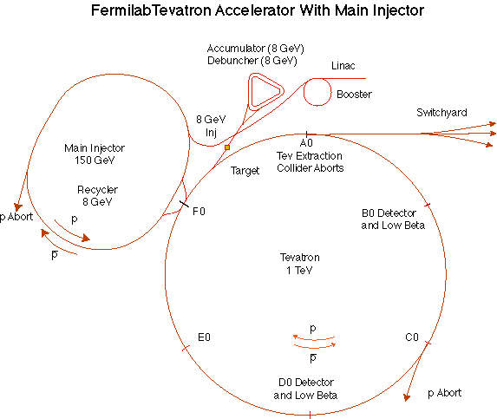
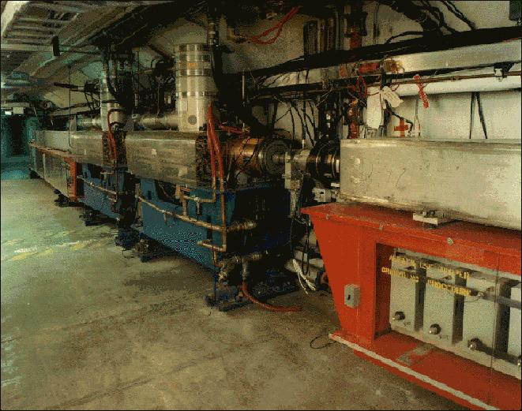
Fermilab Booster
Accelerates protons from 400 MeV to 8 GeV
Operates in a 15 Hz resonant circuit
No time for beam manipulation
Can’t make required beam structure
Sets a fundamental clock for the complex
15 Hz “tick”
Sets a fundamental unit of protons
1 “batch” = up to ~4x10¹² protons
Since the can’t make the beam we need, how do we do it?
By using almost everything else!

Slide 46
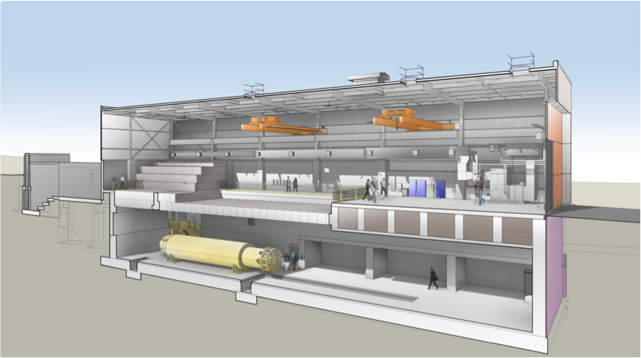
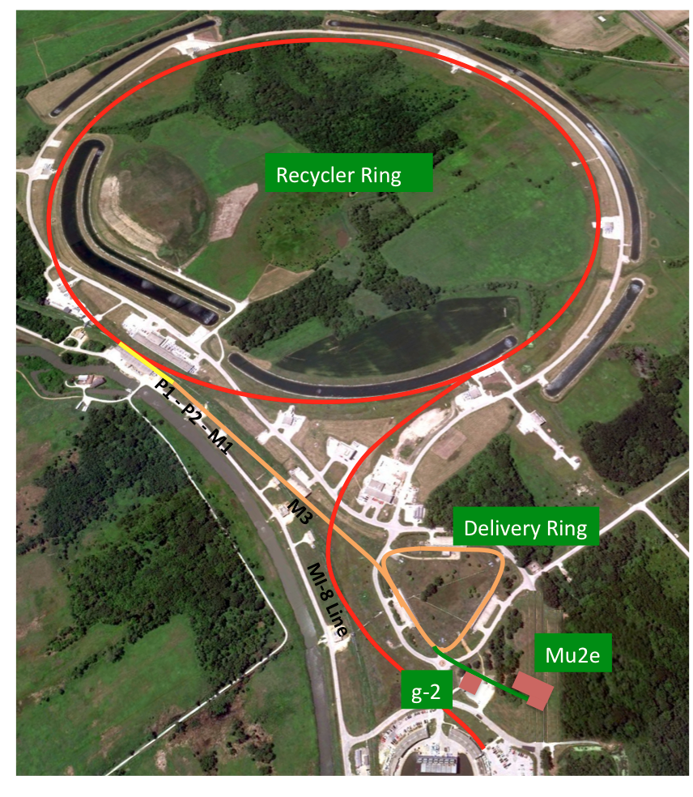
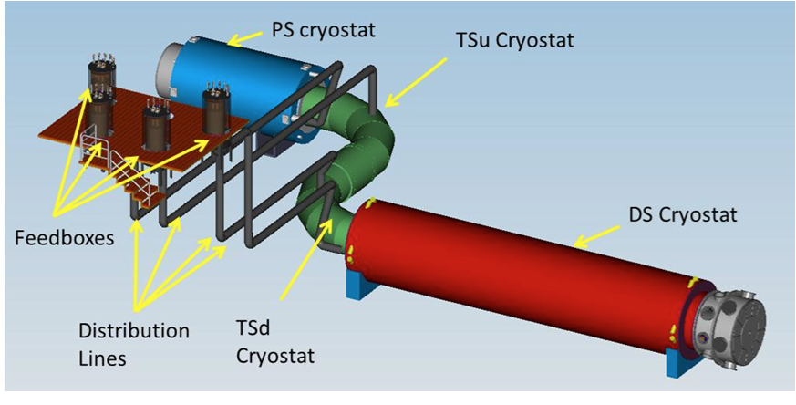
Orientation

Slide 47
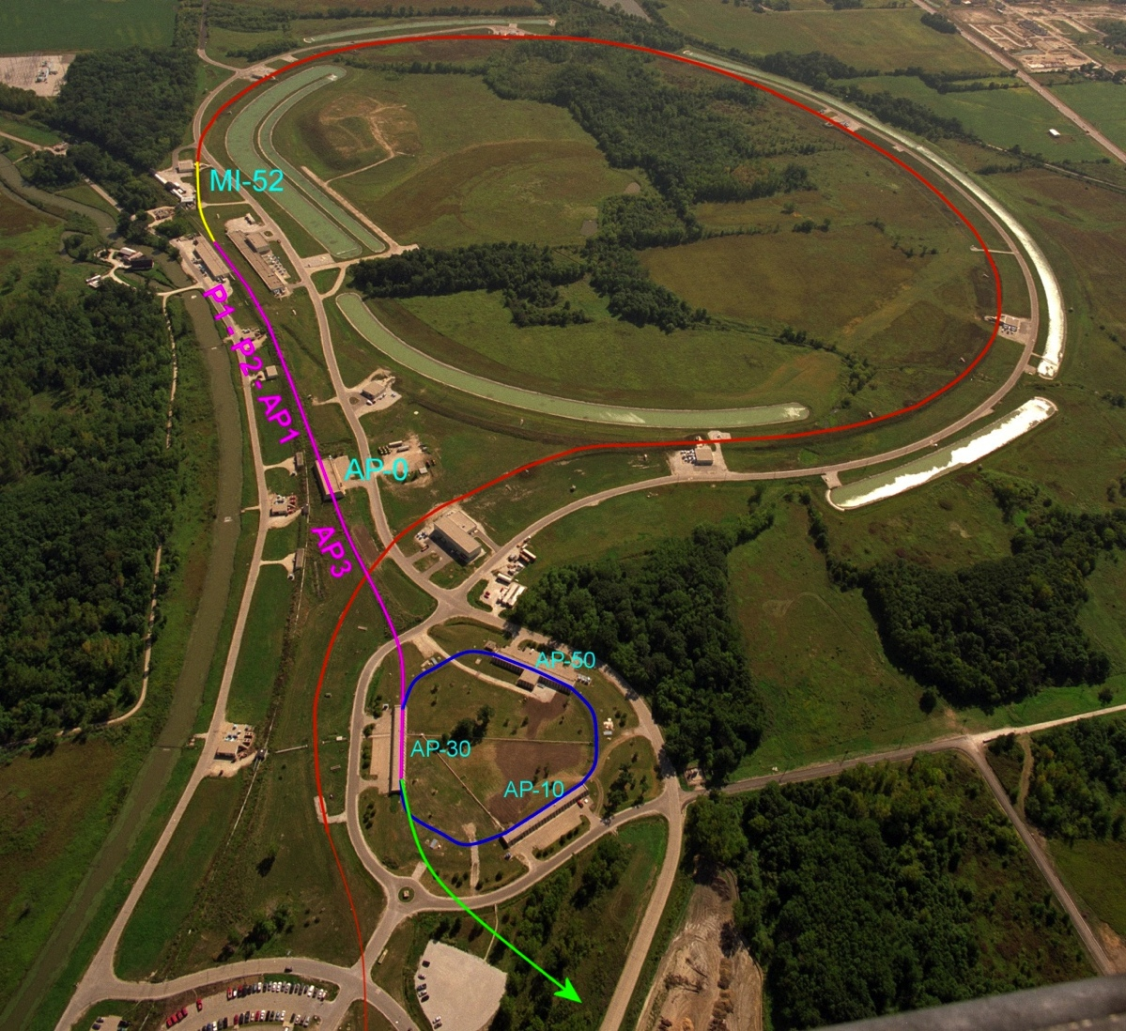
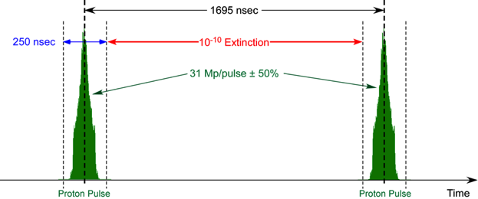
Mu2e Proton Delivery
One Booster “batch” is injected into the Recycler (8 GeV storage ring).
4x10¹² protons
1.7 μsec long
It is divided into 4 bunches of 10¹² each
These are extracted one at a time to the Delivery Ring
Period = 1.7 μsec
As a bunch circulates, it is resonantly extracted to produce the desired beam structure.
Bunches of ~3x10⁷ protons each
Separated by 1.7 μsec
Main Injector/Recycler
Delivery Ring (formerly pBar Debuncher)
Mu2e
Booster
Exactly what we need

Slide 48
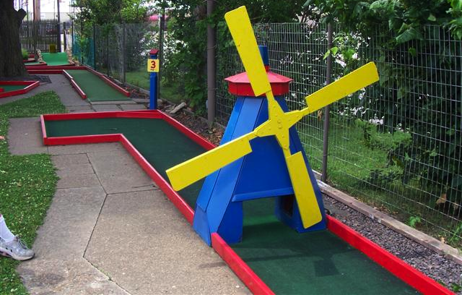
Eliminating out of Time Beam (Extinction)
A set of resonant dipoles in the beam deflects beam such that only in-time beam is transmitted through a system or collimators:
Think miniature golf
Angular deflection
Spatial offset

Slide 49
Extinction Monitor
Achieving 10⁻¹⁰ extinction is hard, but it’s not useful unless we can verify it.
Must measure extinction to 10⁻¹⁰ precision
Roughly 1 proton every 300 bunches!
Monitor sensitive to single particles not feasible
Would have to be blind to the 3x10⁷ particles in the bunch.
Focus on statistical technique
Design a monitor to detect a small fraction of scattered particles from target
10-50 per in-time bunch
Good timing resolution
Statistically build up precision profile for in time and out of time beam.
Goal
Measure extinction to 10⁻¹⁰ precision in a few hours

Slide 50
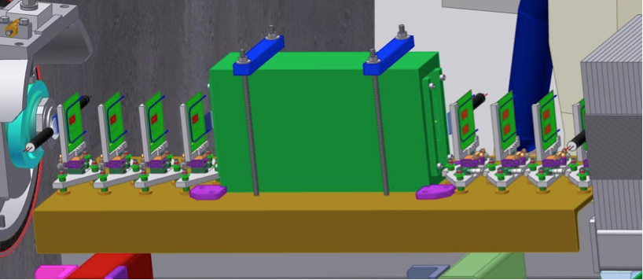
Extinction Monitor Design
Selection channel built into target dump channel
Spectrometer based on 8 planes of ATLAS pixels
Optimized for few GeV/c particles

Slide 51
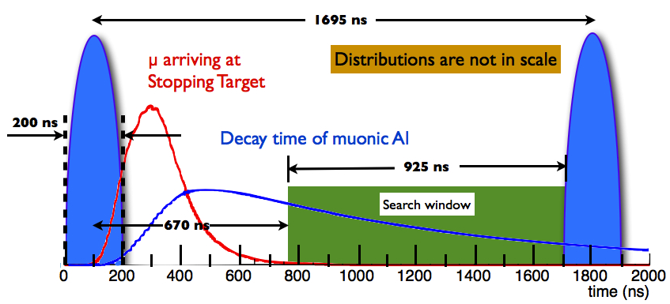
End Product
Target data set: ~3.6x10²⁰ protons in ~3 years

Slide 52
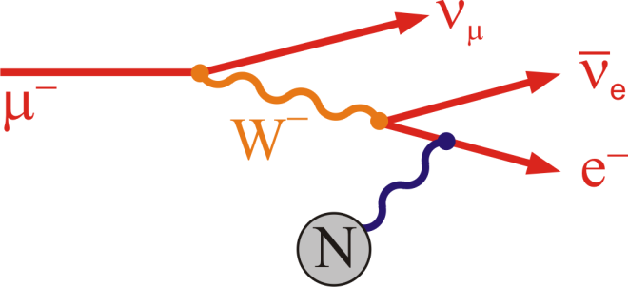
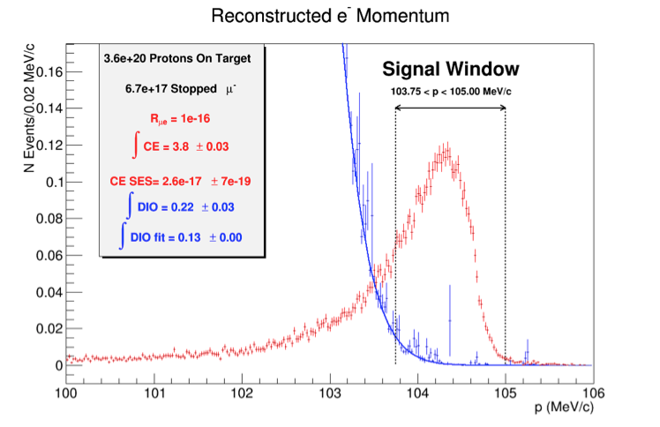
Major Backgrounds Revisisted
1. Muon decay in orbit (DIO)
μ⁻ → e⁻νν
E_{e} < m_{μ}c² – E_{NR} – E_{B}
N ∼ (E_{conversion} - E_{e})⁵
Fraction within 3 MeV of endpoint ∼ 5x10⁻¹⁵
Defeated by good energy resolution

Slide 53
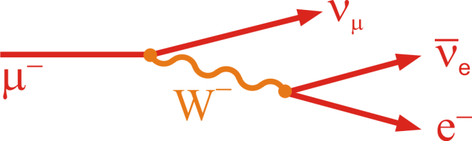
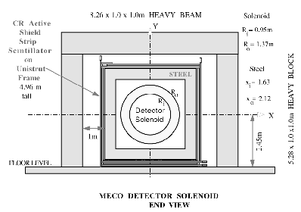
Major Backgrounds (cont’d)
2. Beam Related Backgrounds
Goal: Prompt background ~equal to all other backgrounds
Radiative π⁻ capture:
π⁻N →N*γ, γZ → e⁺e⁻
Muon decay in flight:
μ⁻ → e⁻νν
Since E_{e} < m_{μ}c²/2, p_{μ} > 77 GeV/c
Beam electrons
Pion decay in flight:
π⁻ → e⁻ν_{e}
Suppressed by minimizing beam between bunches and waiting
Need ≲ 10⁻¹⁰ extinction (see previous discussion)
3. Asynchronous Backgrounds
Cosmic rays
suppressed by active and passive shielding

Slide 54
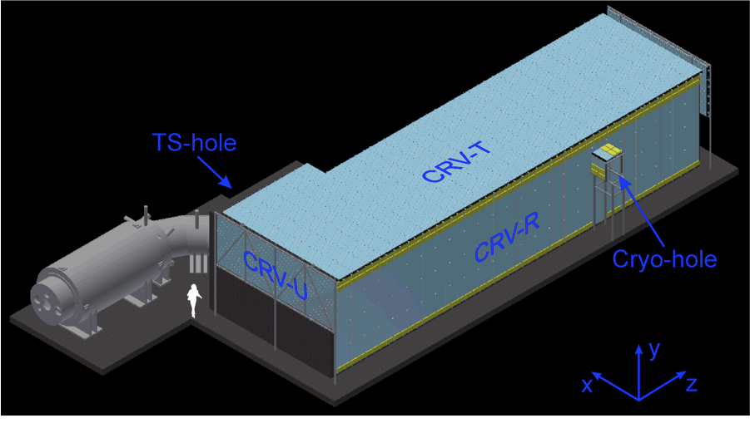
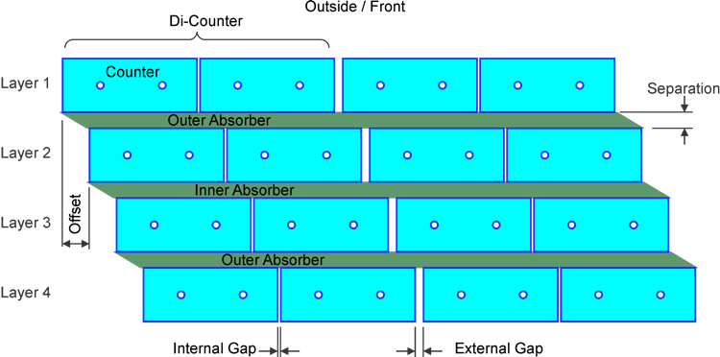
Cosmic Ray Veto (CRV)
Multiple layers of scintillator panels surround detector to veto cosmic rays
Efficiency specification: >99.99%

Slide 55
Sensitivity
Cuts chosen to maximize signficance
3.6x10²⁰ protons on target
3 years nominal running
Single Event Sensitivity: R_{μe}=2.9x10⁻¹⁷

Slide 56
Significance
Backgrounds
Bottom line:
Single event sensitivity: R_{μe}=3x10⁻¹⁷
90% C.L. (if no signal) : R_{μe}<7x10⁻¹⁷
Typical SUSY Signal: ~40 events or more
4 order of magnitude improvement!

Slide 57
A long time coming
1992 | Proposed as “MELC” at Moscow Meson Factory
1997 | Proposed as “MECO” at Brookhaven (at this time, experiment incompatible with Fermilab)
1998-2005 | Intensive work on MECO technical design
July 2005 | Entire rare-decay program canceled at Brookhaven
2006 | MECO subgroup + Fermilab physicists work out means to mount experiment at Fermilab
Fall 2008 | Mu2e Proposal submitted to Fermilab
November 2008 | Stage 1 approval. Formal Project Planning begins
November 2009 | DOE Grants CD-0
July 2012 | CD-1
March 2015 | CD-2/3b
In DOE project-speak, this is the first “Critical Decision”: Statement of mission need = official existence
Approval of baseline and money for long lead elements
Things are really happening

Slide 58
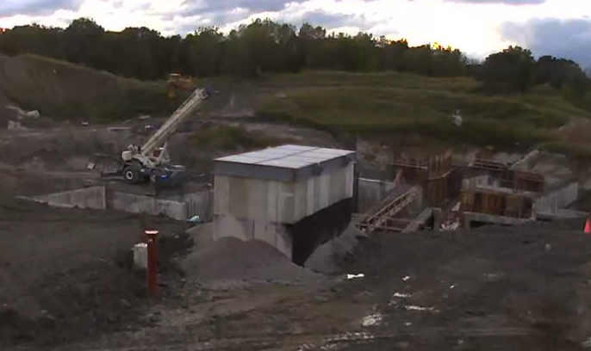
Civil Construction

Slide 59
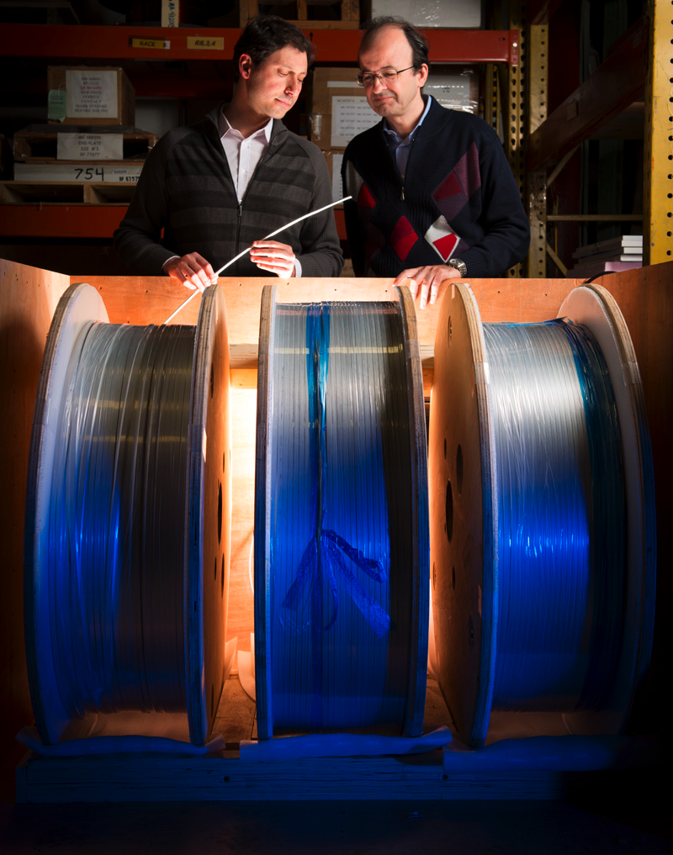
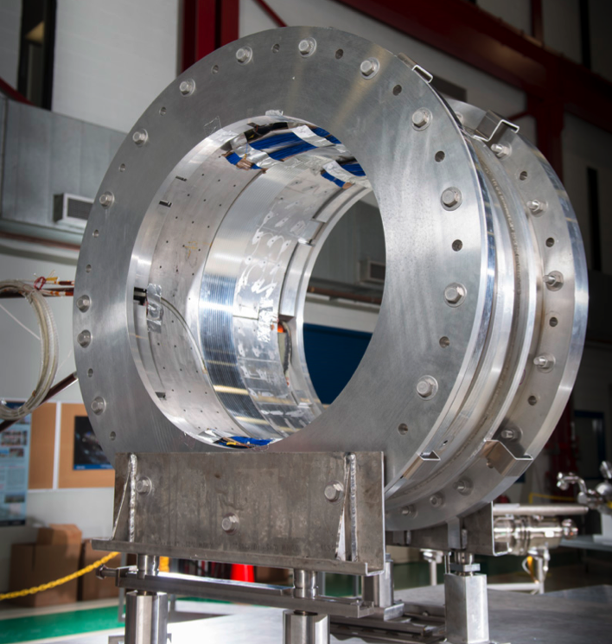
Magnet Procurement and Testing
Successful test of Transport Solenoid segment
Cable acceptance

Slide 60



Detectors
Calorimeter Crystal Test
Straw Tube Tracker
Cosmic Ray Veto

Slide 61
Schedule

Slide 62

What if we see something?
R. Bernstein
Next questions:
What’s the μ➔eγ signal (if any)
What’s the target dependence?

Slide 63
Upgrade scenarios
Mu2e Signal?
No
Yes
Both prompt and DIO backgrounds must be lowered to measure
Must upgrade all aspects of production, transport and detection.
Must compare different targets.
Optimize muon transport and detector for short bound muon lifetimes.
Backgrounds might not be as important.
Rμe ~ 10⁻¹⁸

Slide 64
Target Dependence
Different models predict different target dependence and different relative rates for μN➔eN and μ➔eγ
Now we know this!

Slide 65
Conclusions
We have proposed a realistic experiment to measure
Single event sensitivity of R_{μe}=3x10⁻¹⁷
This represents an improvement of four orders of magnitude compared to the existing limit, or over a factor of ten in effective mass reach. For comparison
TeV -> LHC = factor of 7 (difference in luminosity makes in comparable)
LEP 200 -> ILC = factor of 2.5
ANY signal would be unambiguous proof of physics beyond the Standard Model
The absence of a signal would be a very important constraint on proposed new models.

Slide 66
Backup Slides

Slide 67
Experimental Challenges for Increased Flux
At our level of sensitivity, we hit fundamental limits with this technique
Simply increasing the proton flux will not improve the limit dramatically
Improve momentum resolution for the ~100 MeV electrons to reject high energy tails from ordinary DIO electrons.
Limited by multiple scattering in target and detector plane
➔ go to bunched, mono-energetic muon beam, allowing for thinner target
Allow longer decay time for pions to decay
Both of these lead to a decay/compressor ring
Other issues with increased flux
Upgrade target and capture solenoid to handle higher proton rate
Target heating
Quenching or radiation damage to production solenoid
High rate detector
All of these efforts will benefit immensely from the knowledge and experience gained during the initial phase of the experiment.
If we see a signal a lower flux, can use increased flux to study in detail
Precise measurement of R_{μe}
Target dependence
Comparison with μ→eγ rate

Slide 68



Preac(cellerator) and Linac
“New linac” (HEL)- Accelerate H- ions from 116 MeV to 400 MeV
“Preac” - Static Cockroft-Walton generator accelerates H- ions from 0 to 750 KeV.
“Old linac”(LEL)- accelerate H- ions from 750 keV to 116 MeV

Slide 69

Main Injector/Recycler
The Main Injector can accept 8 GeV protons OR antiprotons from
Booster
The anti-proton accumulator
The 8 GeV Recycler (which shares the same tunnel and stores antiprotons)
It can accelerate protons to 120 GeV (in a minimum of 1.4 s) and deliver them to
The antiproton production target.
The fixed target area.
The NUMI beamline.
It can accelerate protons OR antiprotons to 150 GeV and inject them into the Tevatron.

Slide 70


Present Operation of Debuncher/Accumulator
Protons are accelerated to 120 GeV in Main Injector and extracted to pBar target
pBars are collected and phase rotated in the “Debuncher”
Transferred to the “Accumulator”, where they are cooled and stacked
pBars not used after collider.

Slide 71
Mu2e in the NOvA era
Beam Delivered in 15 Hz “batches” from the Fermilab Booster

Slide 72


Extinction Performance
Beam motion in Collimator
Bunch
Transmission Window
Additional 10⁻⁵ extinction from beam delivery system

Slide 73
Direct vs. Indirect Observation
Direct
Indirect

Slide 74
Review: Particle Motion in a Solenoidal Field
Generally, particles move in a helical trajectory
For high momentum particles,
the curvature is used to measure
the momentum
Low momentum particles are effectively “trapped” along the field lines
A particle trapped along a curved solenoidal field will drift out of the plane of curvature with a velocity
10 MeV/c particle will have a radius of 3 cm in a 1 T field
Can be used to resolve charge and momentum!

Slide 75
Resonant Extraction
Extracting all the beam at once is easy, but we want to extract it slowly over ~60 ms (~35,000 revolutions)
Use nonlinear (sextupole) magnets to drive a harmonic instability
Extract unstable beam as it propagates outward
Standard technique in accelerator physics
Unstable beam motion in N(order) turns
Extraction Field
Extracted beam
Lost beam
Septum

Slide 76

Mu2e Spill Structure
1.33 sec Main Injector cycle
Detail:
3x10⁷ p/bunch
1.7 μsec bunch spacing
~30% duty factor
~1.2x10²⁰ protons year

